Slide 1


trusted engineering partner for digital transformation
www.griddynamics.com
Deep Learning for Graphs
MARCH 2024
Notes:
Introduction
Motivation
Use Cases
Build intuition about these models
Understand how they work
Review some of the tests I have conducted
Motivation
Previous dataset
Graphs are everywhere
World Wide Web
Chemical molecules
Social Networks
Something new

Slide 2
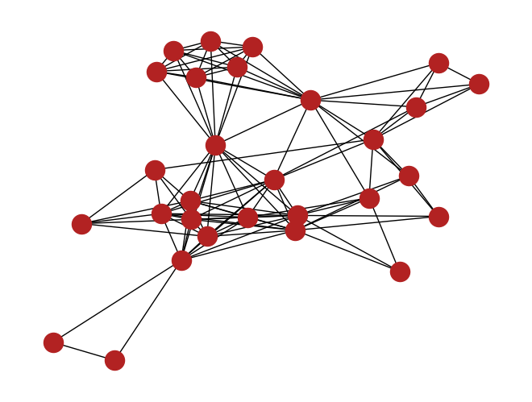
Agenda
Basics of Deep Learning
DBLP dataset and defining the problem statement
MLP
Analogy for GNNs
Building our GCN
GCN
Outcomes
Further scope
Notes:
Why graphs
Graphs are everywhere

Slide 3

Deep Learning basics
Learn f(x)
Loss function
Complex function which maps inputs to outputs
Goal is to learn the parameters for this function and use it to predict for unknown inputs
e.g. slope, intercept in Linear Regression
Metric that measures the difference between the predicted and actual values
Learning involves reducing the value of the loss function metric
e.g. MSE
Models
Gradient Descent
Defines the structure of f(x)
Use case dependent
CNNs for images, RNNs for text generation etc.
Analogous to selecting a cubic, quadratic or linear function to fit the data
Process of moving in a direction to reduce the loss
Testing and Evaluation
Supervised/Unsupervised
(input, desired output) available
Unsupervised uses statistical measures
e.g. clustering

Slide 4
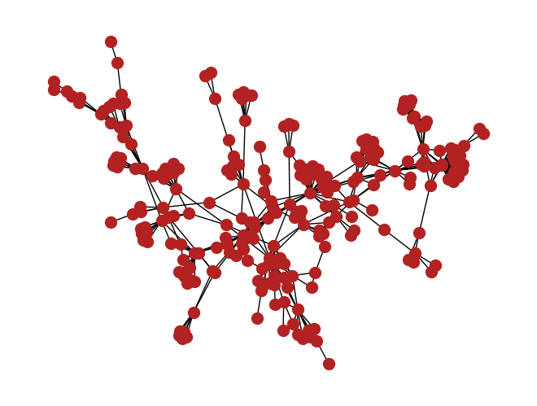
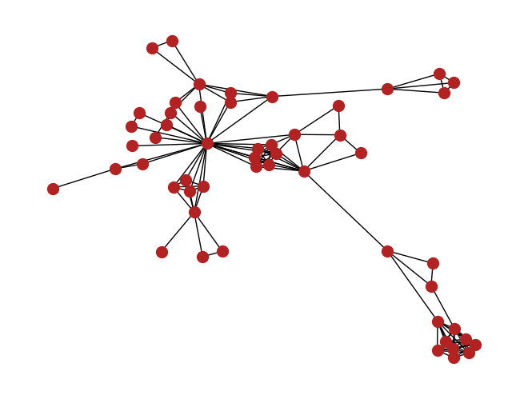
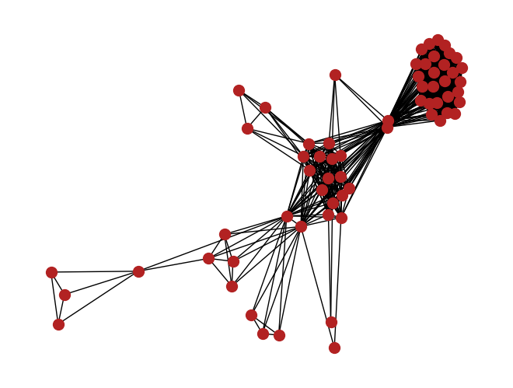
DBLP Dataset and problem formulation
Dataset
Use cases
Graph data
317080 Nodes and 1049866 edges
Nodes divided into 5000 overlapping communities
Market/Audience segmentation
Recommender systems
Fraud Detection
Defining the problem statement
Approach
Supervised Community Detection + Node classification
For each node we need to predict the communities it belongs to
Input: Graph (nodes and edges)
Output: Matrix M, where each entry m_{i,j} = 1 if node i is a member of community j else 0

Slide 5
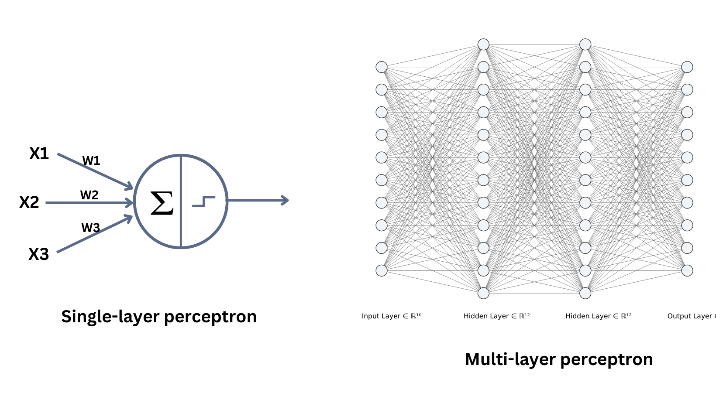

Slide 6
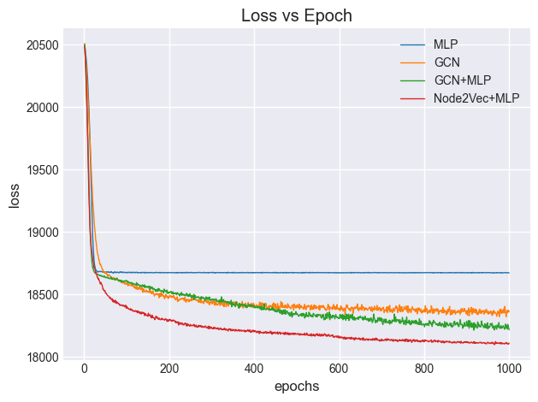
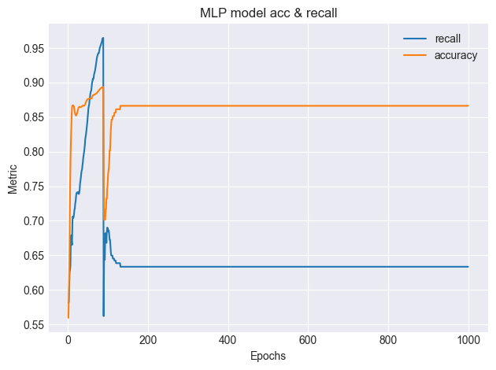

Slide 7
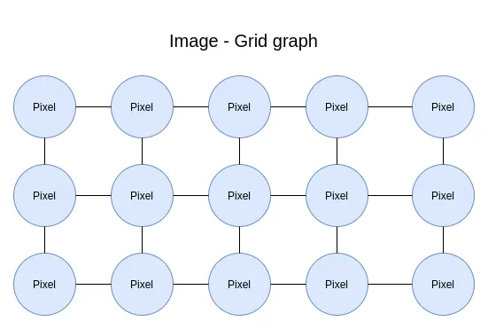
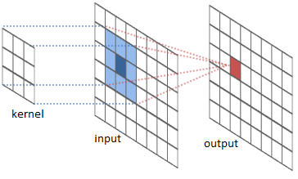
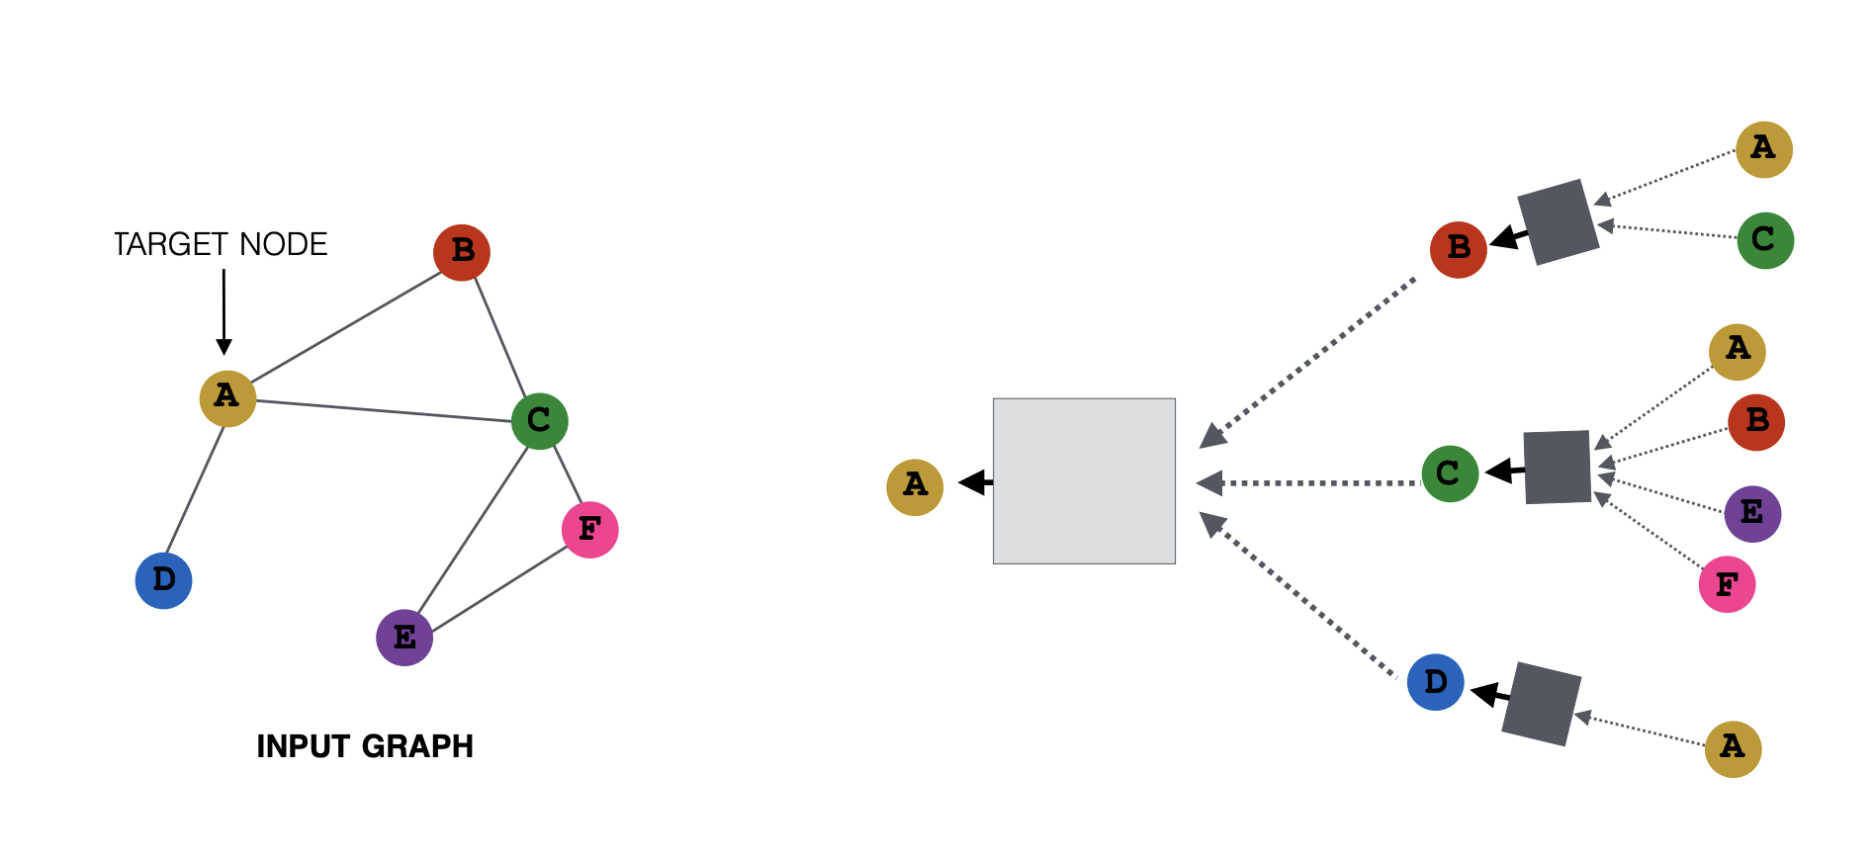
GNNs are analogous to CNNs
Images
Images are a type of graph with a fixed structure.
Kernels perform neighbourhood aggregation
Graphs
Inconsistent structure
No inherent ordering
Local neighbourhoods networks perform aggregation

Slide 9
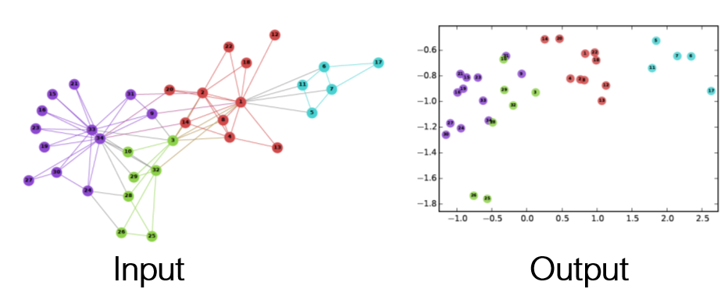
Feature Engineering
Graph Statistics
Use node based statistical measures as features
Often graph networks are unable to easily learn some of these
E.g. degree, clustering coefficient, centrality
Embedding Technique
Node2Vec is Word2Vec for graph nodes
Embeds nodes as a vectors
Closer nodes are embedded closer in the vector space

Slide 10
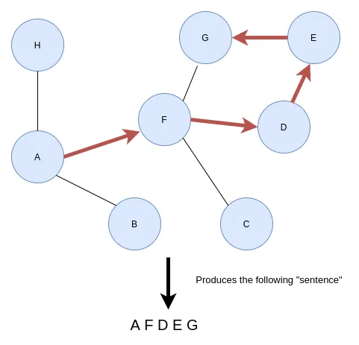
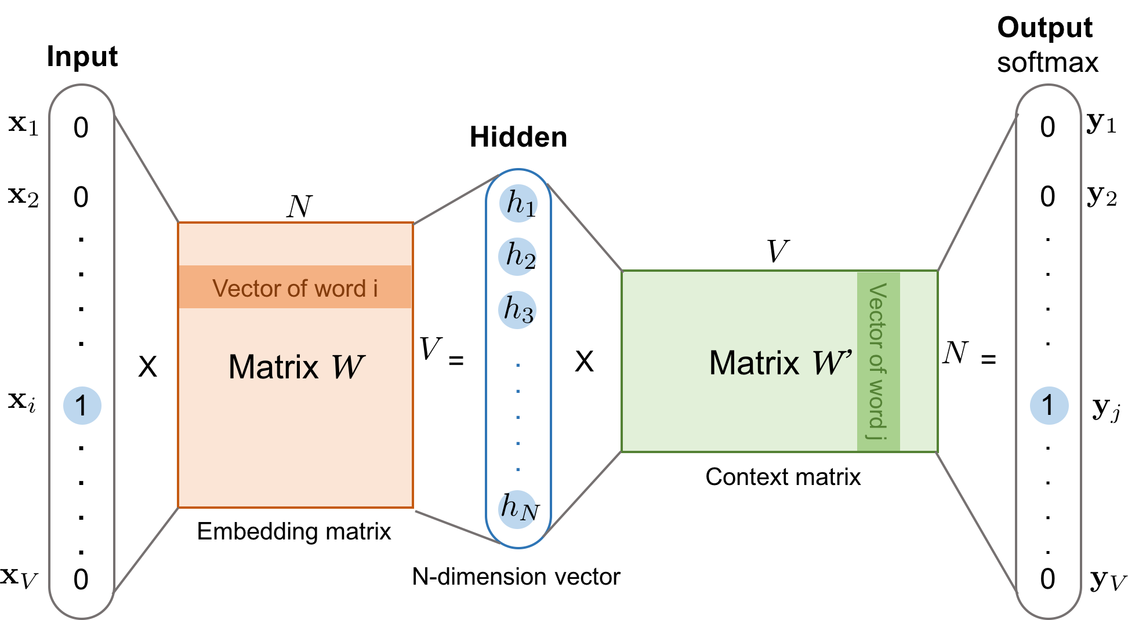
Node2Vec algorithm
Sentence generation based on walk length and walks per node
Training samples generated for each node based on window size (input,target)
The skip-gram model is trained on (input,target) training samples.
Finally the hidden dimension is used as the embedding

Slide 11
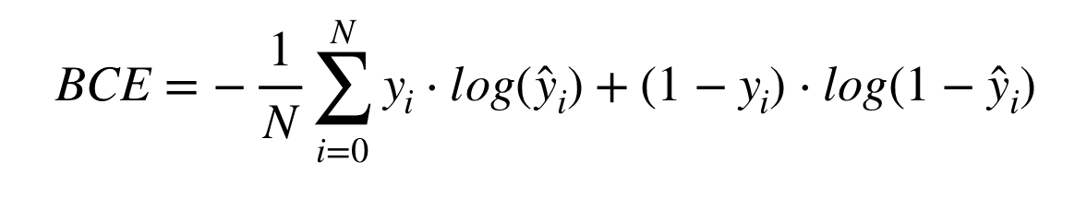

Loss Function
To solve this we use weighted BCE loss for sparse matrices.
W_{true} is the relative cost of predicting a 1 as a 0
W_{false} is the relative cost of predicting a 0 as a 1
W_{true} >>> W_{false} makes the algorithm to increase recall as well as the accuracy
The Loss function is important because gradient descents goal is to minimize the loss
Output matrix is sparse (~2% 1s only), which causes high accuracy and low recall while using regular BCELoss
i.e. predicts all zeroes

Slide 12
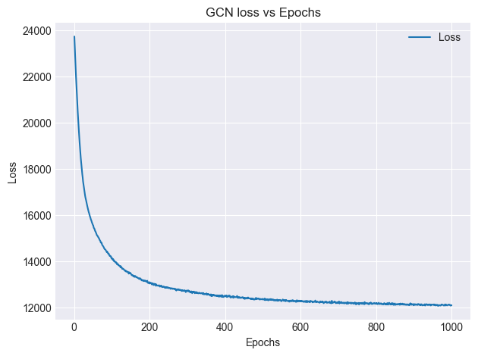
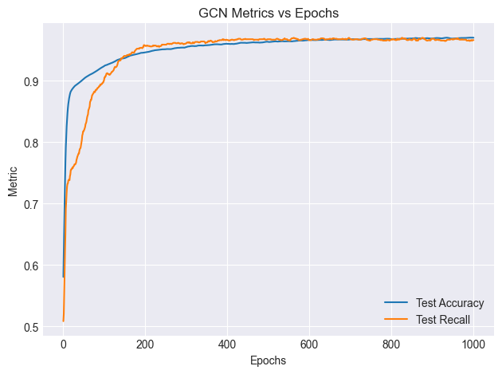
GCN training loss and evaluation metrics
200 communities and 50% randomly sampled edges

Slide 13
Limitations & Improvements
GraphSAGE implementation for entire dataset
It is a model specifically designed for large graphs
Testing different structures, activation functions and loss functions
Adding skip connections to models
Feature engineering
Learnable features
Removing dependency on Node2Vec algorithms

Slide 14
Edge Sampling
Dataset Size
Takeaways
Edges retained | 75% | 56.25% | 42.18% | 31.64%
MLP | 87.32% | 87.14% | 87.19% | 87.18%
GCN | 89.2% | 86.68% | 86.95% | 87.74%
GCN + MLP processing | 87.8% | 87.77% | 87.45% | 87.58%
Node2Vec + MLP | 93.2% | 90.58% | 89.48% | 88.57%
MLP model doesn’t take edges as inputs so it is independent of edge sampling.
Node2Vec + MLP model is the most reliable and accurate.
Performance of GCN models decreases as the number of edges are reduced
Takeaways
Graph Networks perform better than the MLP model in all cases, as they leverage edge information.
Increase in graph size corresponds to increase in the number of edges and nodes which graph networks leverage to predict more accurately.
Node2Vec performs the best in all categories.
Number of communities | 50 | 100 | 200 | 500
MLP | 76.8% | 86.2% | 86.73% | 91.9%
GCN | 83.83% | 87.4% | 89.69% | 92.05%
GCN + MLP processing | 86.67% | 87.52% | 88.91 | 92.94%
Node2Vec + MLP | 91.28% | 91.61% | 92.94% | 93.21%

Slide 15
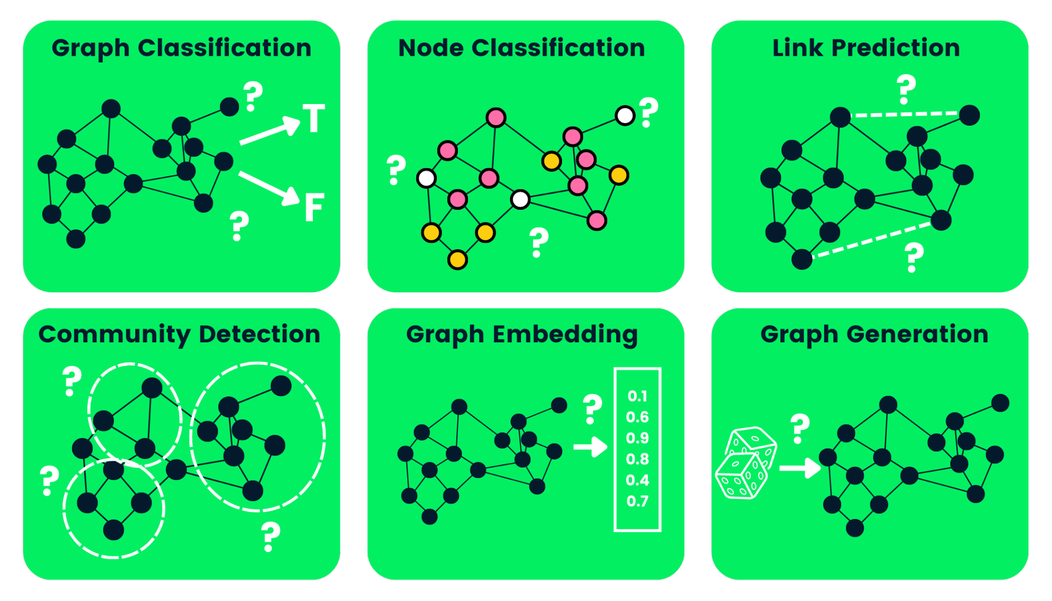
Graph Networks and their applications
Notes:
Graph Classification: Molecule toxicity
Link prediction: new friend suggestions in social networks
Community detection: social networking to find groups
Graph generation: Possible drug molecule structures
Knowing what all graph networks can do

